Slide 1
?
A
B
C
Fixed wheel
Turnable wheel
Heading

Slide 2
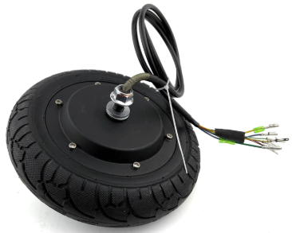
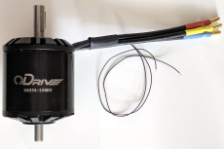
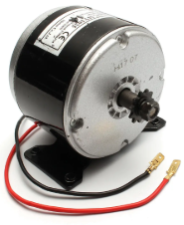
?
A
B
C
Brush less Hub motor
Brush less normal dual shaft
Brushed motor

